Slide 1
Actief filter 13: High Pass
Jelle Caerlen

Slide 3
DC- weergave en HF-weergave
H(0) = 0 H(∞)= 2 = +6 dB

Slide 4
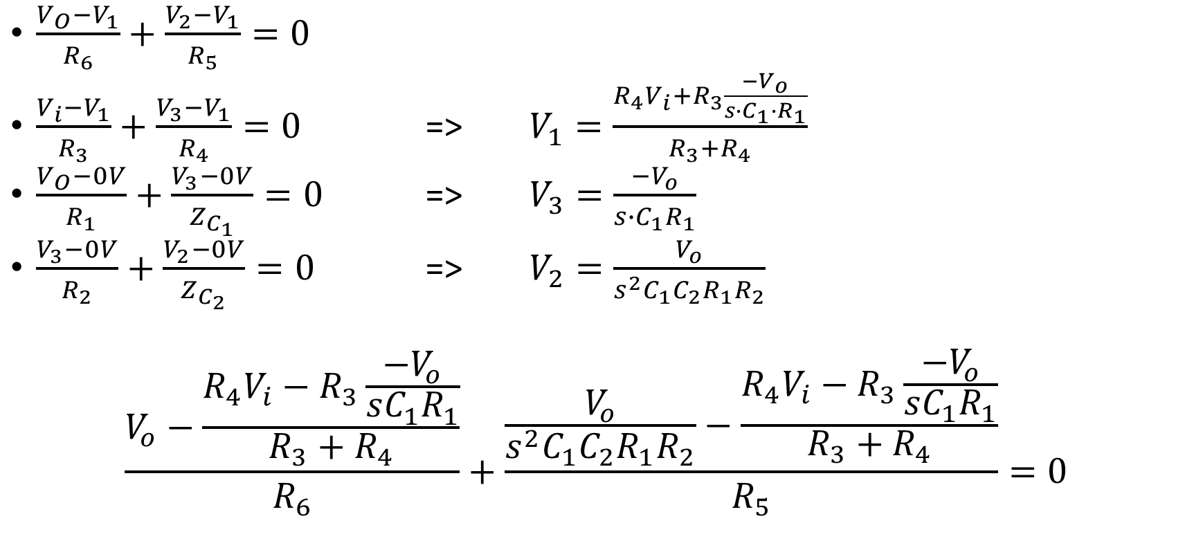
Bereken H(s)
$\frac{V_{O}−V_{1}}{R_{6}}+\frac{V_{2}−V_{1}}{R_{5}}=0$
$\frac{V_{i}−V_{1}}{R_{3}}+\frac{V_{3}−V_{1}}{R_{4}}=0$ => $V_{1}=\frac{R_{4}V_{i}+R_{3}\frac{−V_{o}}{s∙C_{1}∙R_{1}}}{R_{3}+R_{4}}$
$\frac{V_{O}−0V}{R_{1}}+\frac{V_{3}−0V}{Z_{C_{1}}}=0$ => $V_{3}=\frac{−V_{o}}{s∙C_{1}R_{1}}$
$\frac{V_{3}−0V}{R_{2}}+\frac{V_{2}−0V}{Z_{C_{2}}}=0$ => $V_{2}=\frac{V_{o}}{s^{2}C_{1}C_{2}R_{1}R_{2}}$
$$\frac{V_{o}−\frac{R_{4}V_{i}−R_{3}\frac{−V_{o}}{sC_{1}R_{1}}}{R_{3}+R_{4}}}{R_{6}}+\frac{\frac{V_{o}}{s^{2}C_{1}C_{2}R_{1}R_{2}}−\frac{R_{4}V_{i}−R_{3}\frac{−V_{o}}{sC_{1}R_{1}}}{R_{3}+R_{4}}}{R_{5}}=0$$

Slide 5
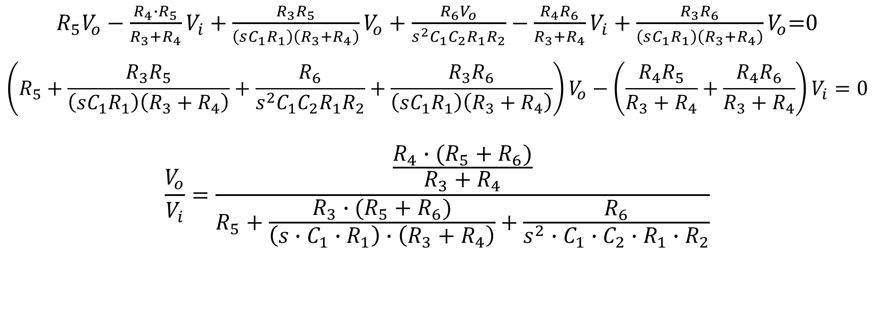
Bereken H(s): vervolg
$R_{5}V_{o}−\frac{R_{4}∙R_{5}}{R_{3}+R_{4}}V_{i}+\frac{R_{3}R_{5}}{\left(sC_{1}R_{1}\right)\left(R_{3}+R_{4}\right)}V_{o}+\frac{R_{6}V_{o}}{s^{2}C_{1}C_{2}R_{1}R_{2}}−$ $\frac{R_{4}R_{6}}{R_{3}+R_{4}}V_{i}+\frac{R_{3}R_{6}}{\left(sC_{1}R_{1}\right)\left(R_{3}+R_{4}\right)}V_{o}$=0
$$\left(R_{5}+\frac{R_{3}R_{5}}{\left(sC_{1}R_{1}\right)\left(R_{3}+R_{4}\right)}+\frac{R_{6}}{s^{2}C_{1}C_{2}R_{1}R_{2}}+\frac{R_{3}R_{6}}{\left(sC_{1}R_{1}\right)\left(R_{3}+R_{4}\right)}\right)V_{o}−\left(\frac{R_{4}R_{5}}{R_{3}+R_{4}}+\frac{R_{4}R_{6}}{R_{3}+R_{4}}\right)V_{i}=0$$
$$\frac{V_{o}}{V_{i}}=\frac{\frac{R_{4}∙(R_{5}+R_{6})}{R_{3}+R_{4}}}{R_{5}+\frac{R_{3}∙(R_{5}+R_{6})}{\left(s∙C_{1}∙R_{1}\right)∙\left(R_{3}+R_{4}\right)}+\frac{R_{6}}{s^{2}∙C_{1}∙C_{2}∙R_{1}∙R_{2}}}$$

Slide 6
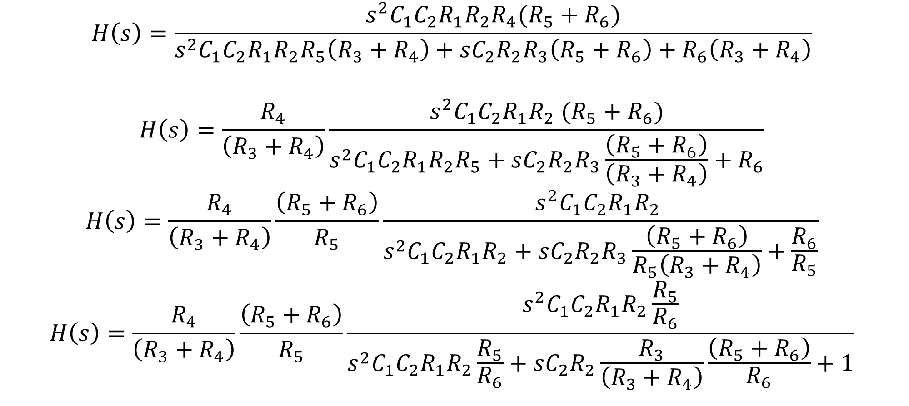
Bereken H(s): vervolg
$$H\left(s\right)=\frac{s^{2}C_{1}C_{2}R_{1}R_{2}R_{4}(R_{5}+R_{6})}{s^{2}C_{1}C_{2}R_{1}R_{2}R_{5}\left(R_{3}+R_{4}\right)+sC_{2}R_{2}R_{3}\left(R_{5}+R_{6}\right)+R_{6}\left(R_{3}+R_{4}\right)}$$
$$H\left(s\right)=\frac{R_{4}}{\left(R_{3}+R_{4}\right)}\frac{s^{2}C_{1}C_{2}R_{1}R_{2} (R_{5}+R_{6})}{s^{2}C_{1}C_{2}R_{1}R_{2}R_{5}+sC_{2}R_{2}R_{3}\frac{\left(R_{5}+R_{6}\right)}{\left(R_{3}+R_{4}\right)}+R_{6}}$$
$$H\left(s\right)=\frac{R_{4}}{\left(R_{3}+R_{4}\right)}\frac{\left(R_{5}+R_{6}\right)}{R_{5}}\frac{s^{2}C_{1}C_{2}R_{1}R_{2} }{s^{2}C_{1}C_{2}R_{1}R_{2}+sC_{2}R_{2}R_{3}\frac{\left(R_{5}+R_{6}\right)}{R_{5}\left(R_{3}+R_{4}\right)}+\frac{R_{6}}{R_{5}}}$$
$$H\left(s\right)=\frac{R_{4}}{\left(R_{3}+R_{4}\right)}\frac{\left(R_{5}+R_{6}\right)}{R_{5}}\frac{s^{2}C_{1}C_{2}R_{1}R_{2}\frac{R_{5}}{R_{6}}}{s^{2}C_{1}C_{2}R_{1}R_{2}\frac{R_{5}}{R_{6}}+sC_{2}R_{2}\frac{R_{3}}{\left(R_{3}+R_{4}\right)}\frac{\left(R_{5}+R_{6}\right)}{R_{6}}+1}$$

Slide 7

Vergelijk H(s) met de algemene transfertfunctie
$$H\left(s\right)=\frac{R_{4}}{R_{3}+R_{4}}\frac{R_{5}+R_{6}}{R_{5}}\frac{s^{2}C_{1}C_{2}R_{1}R_{2}\frac{R_{5}}{R_{6}}}{s^{2}C_{1}C_{2}R_{1}R_{2}\frac{R_{5}}{R_{6}}+sC_{2}R_{2}\frac{R_{3}}{R_{3}+R_{4}}\frac{R_{5}+R_{6}}{R_{6}}+1}$$
$$H\left(s\right)=K\frac{{(\frac{s}{ω_{n}})}^{2}}{{(\frac{s}{ω_{n}})}^{2}+\frac{1}{Q}\frac{s}{ω_{n}}+1}$$

Slide 8



Bepaling $f_{n}$
$${\left|H\right|}_{dB}$$
6dB
-34dB
100Hz 1kHz
$$40\frac{dB}{dec}$$
x100
x10

Slide 9
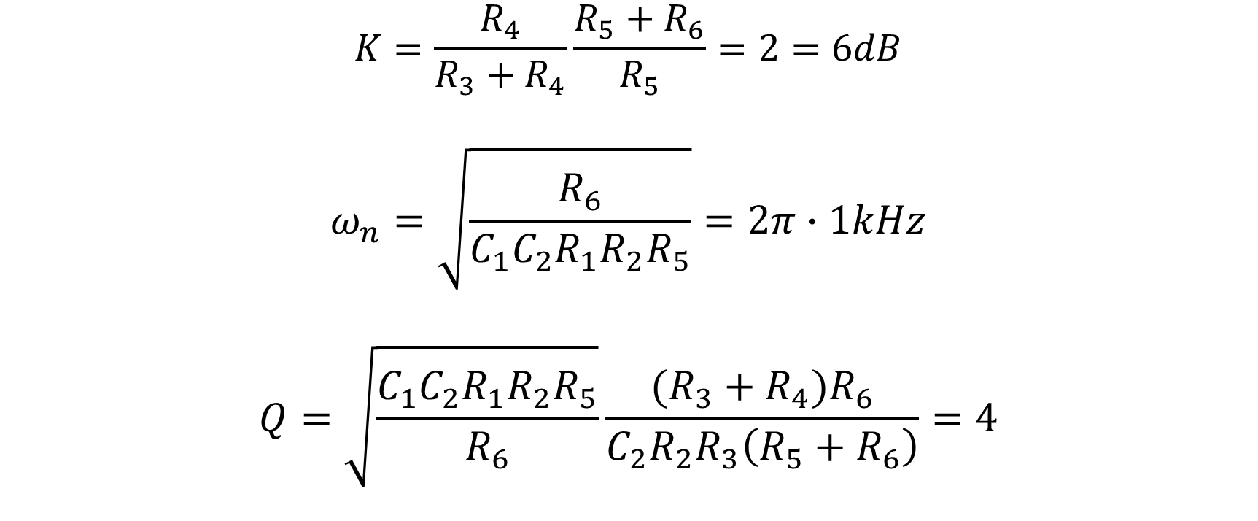
Karakteriseer
$$K=\frac{R_{4}}{R_{3}+R_{4}}\frac{R_{5}+R_{6}}{R_{5}}=2=6dB$$
$$ω_{n}=\sqrt{\frac{R_{6}}{C_{1}C_{2}R_{1}R_{2}R_{5}}}=2π∙1kHz$$
$$Q=\sqrt{\frac{C_{1}C_{2}R_{1}R_{2}R_{5}}{R_{6}}}\frac{(R_{3}+R_{4})R_{6}}{C_{2}R_{2}R_{3}\left(R_{5}+R_{6}\right)}=4$$

Slide 10
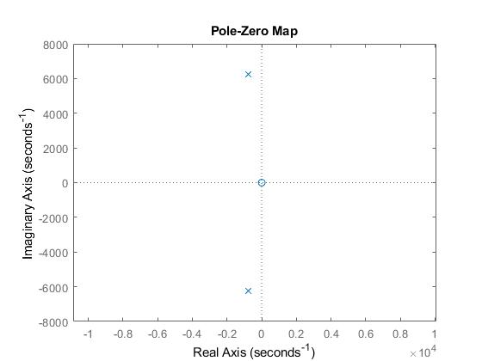
Pole-zero plot

Slide 11
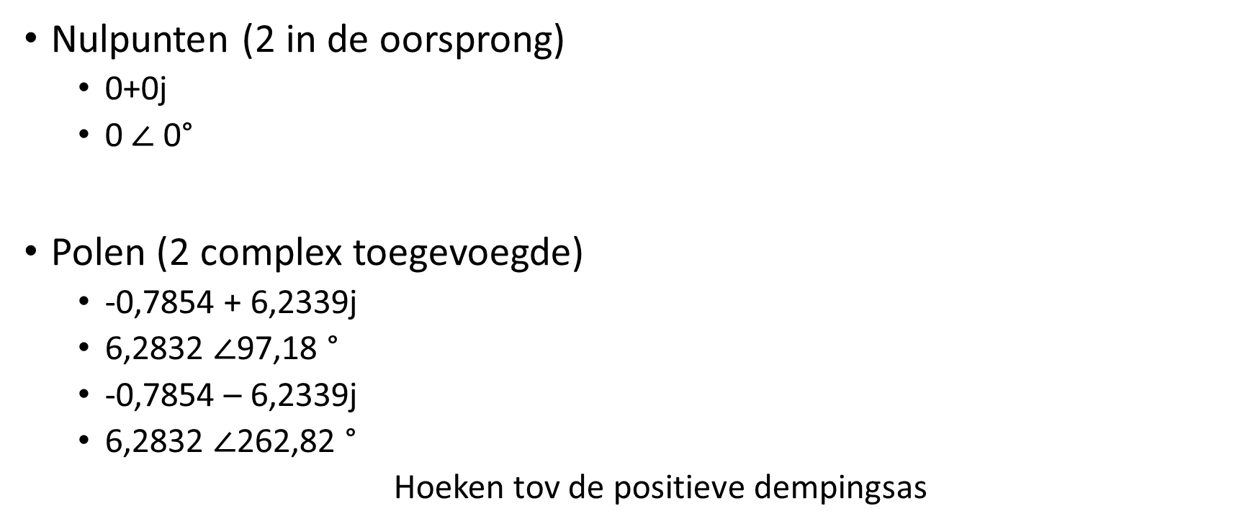
Ligging polen en nulpunten
Nulpunten (2 in de oorsprong)
0+0j
0 $∠$ 0°
Polen (2 complex toegevoegde)
-0,7854 + 6,2339j
6,2832 $∠$97,18 °
-0,7854 – 6,2339j
6,2832 $∠$262,82 °
Hoeken tov de positieve dempingsas

Slide 12
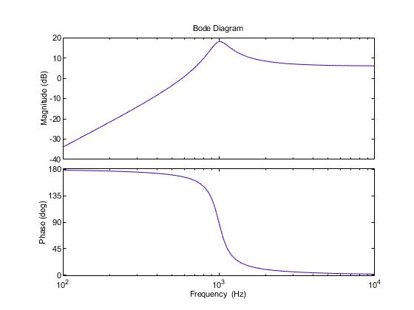
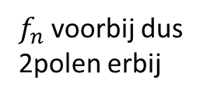
Analyse frequentiegedrag
Q
K
+40dB/dec
$f_{n}$ voorbij dus 2polen erbij
2 nulpunten

Slide 13
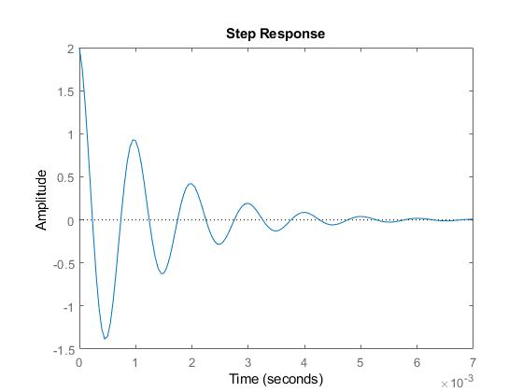
Analyse tijdsgedrag

Slide 14
Analyse tijdsgedrag: vervolg
Begin = 2
Eind = 0
Demping =
Frequentie =

Slide 15

Ontwerpvergelijkingen
$K=\frac{R_{4}}{R_{3}+R_{4}}\frac{R_{5}+R_{6}}{R_{5}}$
${(\frac{s}{ω_{n}})}^{2}=s^{2}C_{1}$ $C_{2}$ $R_{1}$ $R_{2}\frac{R_{5}}{R_{6}}$
$\frac{1}{Q}\frac{s}{ω_{n}}=sC_{2}R_{2}\frac{R_{3}}{R_{3}+R_{4}}\frac{R_{5}+R_{6}}{R_{6}}$

Slide 16

1ste vergelijking
$$K=\frac{R_{4}}{R_{3}+R_{4}}\frac{R_{5}+R_{6}}{R_{5}}$$
$$K= \frac{R}{R+R}\frac{R+R_{6}}{R}$$
$$2KR=R+R_{6}$$
$$R_{6}=\left(2K−1\right)R$$

Slide 17

2de vergelijking
$$({\frac{s}{ω_{n}})}^{2}=s^{2}C_{1} C_{2} R_{1} R_{2}\frac{R_{5}}{R_{6}}$$
$$\frac{1}{ω_{n}^{2}}=C_{1}\frac{R^{3}}{R_{6}}$$
$$C_{1}=\frac{2K−1}{{(Rω_{n})}^{2}}$$

Slide 18
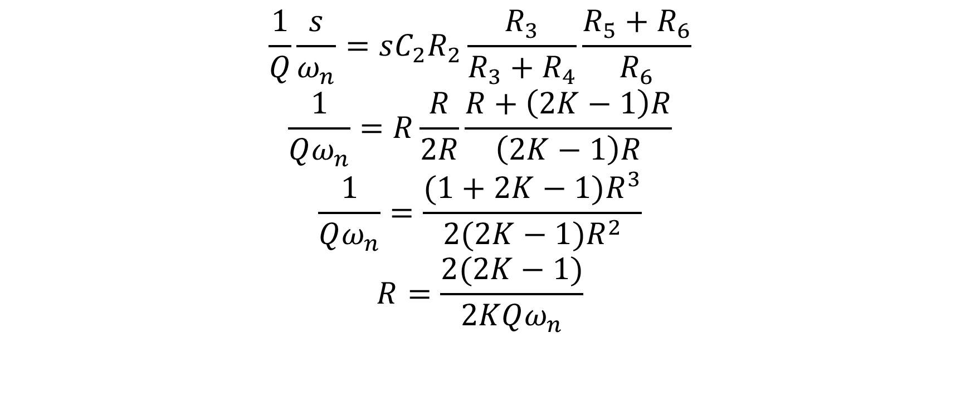
3de vergelijking
$$\frac{1}{Q}\frac{s}{ω_{n}}=sC_{2}R_{2}\frac{R_{3}}{R_{3}+R_{4}}\frac{R_{5}+R_{6}}{R_{6}}$$
$$\frac{1}{Qω_{n}}=R\frac{R}{2R}\frac{R+\left(2K−1\right)R}{\left(2K−1\right)R}$$
$$\frac{1}{Qω_{n}}=\frac{(1+2K−1)R^{3}}{2(2K−1)R^{2}}$$
$$R=\frac{2(2K−1)}{2KQω_{n}}$$

Slide 19
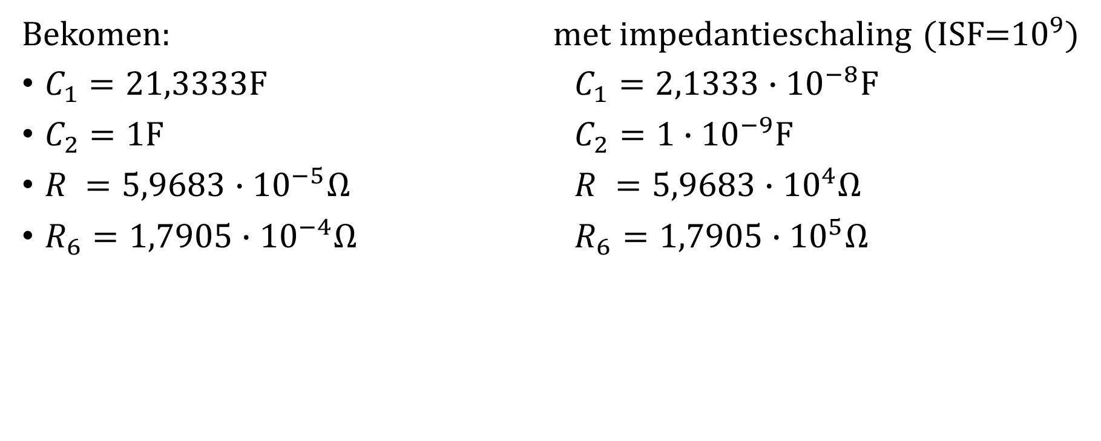
Componentwaarden
Bekomen: met impedantieschaling (ISF=${10}^{9}$)
$C_{1}=21,3333F$ $C_{1}=2,1333∙{10}^{−8}F$
$C_{2}=1F$ $C_{2}=1∙{10}^{−9}F$
$R =5,9683∙{10}^{−5}Ω$ $R =5,9683∙{10}^{4}Ω$
$R_{6}=1,7905∙{10}^{−4}Ω$ $R_{6}=1,7905∙{10}^{5}Ω$

